Slide 1
Urban Culture Through Taste
Aniketh Satyanarayana, Sejoon Park, Shilpi Kumari, Swetha Vijaya Raju, Yong Zhao

Slide 2

Problem Statement
The project aims to identify the urban culture of different neighborhoods through the food preferences of people.
Image by iStock

Slide 3
Topic Inspiration
Inspired from the paper The Geography of Taste.
Department of Architecture and Landscape Architecture, Pennsylvania State University, University Park, PA 16801, USA
Department of Architectural Engineering, Pennsylvania State University, University Park, PA 16801, USA
Department of Geography, Pennsylvania State University, University Park, PA 16801, USA

Slide 4

Problem Statement
Food choice, drink choice, and restaurant ambience can be good indicators of socioeconomic status of the ambient population in different neighborhoods.
The project aims to identify the urban culture of different neighborhoods through the food preferences of people.
The end result of this project would help urban designers to understand the social dynamics of contemporary cities and design more user-friendly and inclusive cities.
This could also act as a food recommendation system by identifying different cuisines of the same concept / taste.
Image by Freely Magazine

Slide 5
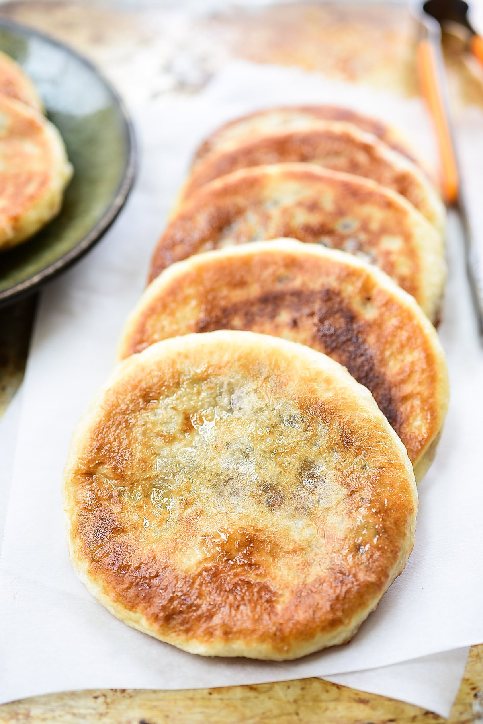
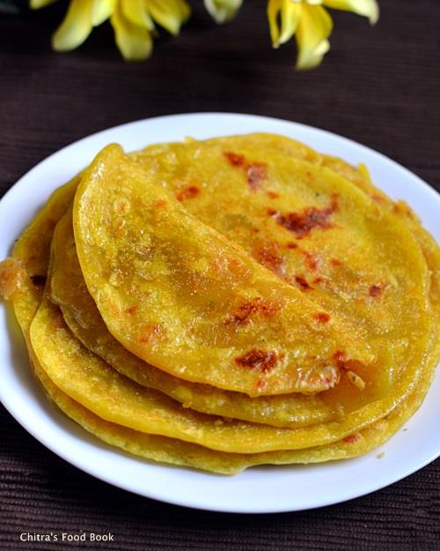
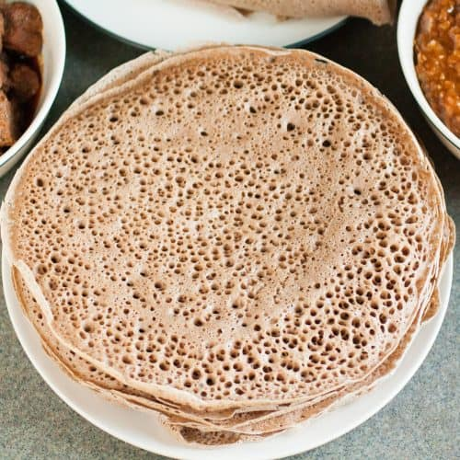
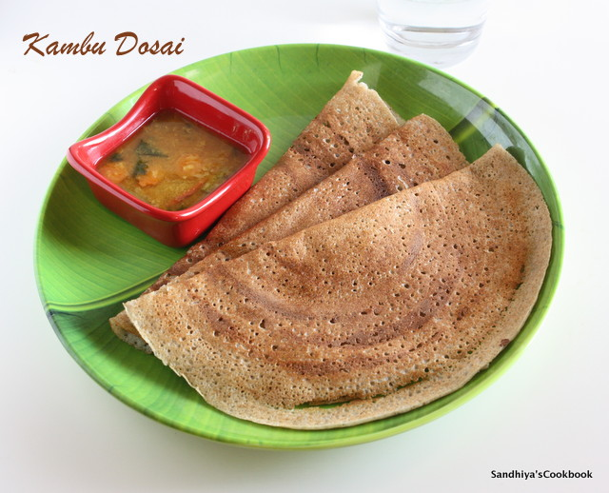
Food is Culture
Korean cuisine, Hotteok (left)
Tamil cuisine, Obbattu (right)
Ethiopian cuisine, Injera (left)
South Indian cuisine, Dosai (right)
Interestingly, Korean and Tamilians have cultural and language similarities too.
Eg. Anni & unnie, vettukili & mettugi, pull & pul.
So, definitely taste of food is an excellent indicator of the urban culture of communities.

Slide 6
Project Idea
Yelp user reviews
distinguish different neighborhoods in terms of their food purchases
identify resultant boundaries in 10 United States metropolitan areas
Natural Language Processing (NLP) techniques
to select a set of potential features pertaining to food, drink and ambience
Identify neighborhoods where similar taste is practiced.
Identify neighborhoods with significant differences based on demographic factors.

Slide 7
Process
Scrape data from food reviews
Convert them to a dataframe.
Feature Generation - Analyse the reviews and introduce columns - binary / ordinal / categorical
Entity names extraction - eg. Ramen, pizza
Taste preference - spicy, bland, cold
Sentiment analysis
Put locations into categories using ML. (Clustering)
Make geoplots showing categories based on demographic factors and tastes.

Slide 8
Datasets
Scrape Yelp / Doordash restaurant review data.
Columns could include,
Restaurant name
Location
Food price
Demography
Date
Rating
Customer review - contains features of the food like,
Taste - spicy, juicy
Quantity

Slide 9
References
The Geography of Taste: Using Yelp to Study Urban Culture
Emotional Landmarks in Cities. The Emotional Life of Cities as Expressed on Social Networks
Natural language processing for urban research

